Slide 1
Application process to the StartSmart CEE acceleration program
on Metabeta platform

Slide 2
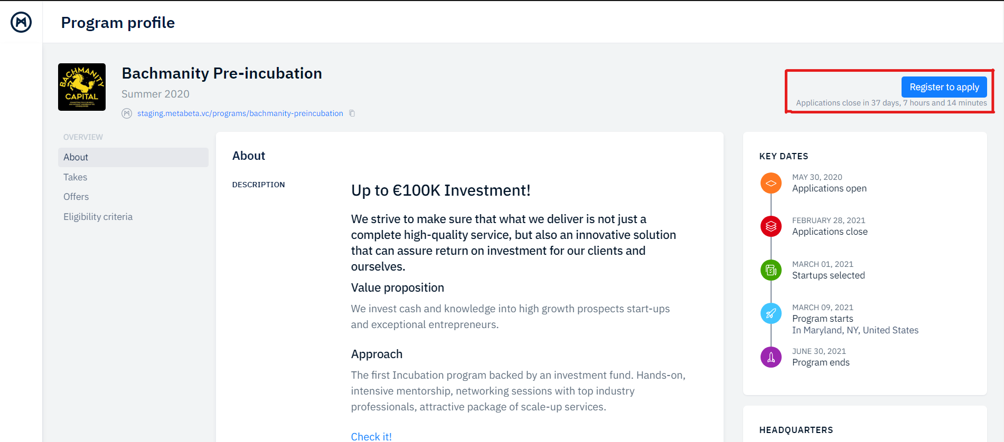
You’ll get on the Metabeta page from our website www.mitefcee.org („Apply now” button) or from our social media accounts.
On this page you can check various details about the program:
Timeline for applying
Description of the program
The takes and the offerings
Other
In order to start your application for the program, you must first create an account.
Click on the “Register to apply” button, in the right-up corner, to create your account and start the application.

Slide 3
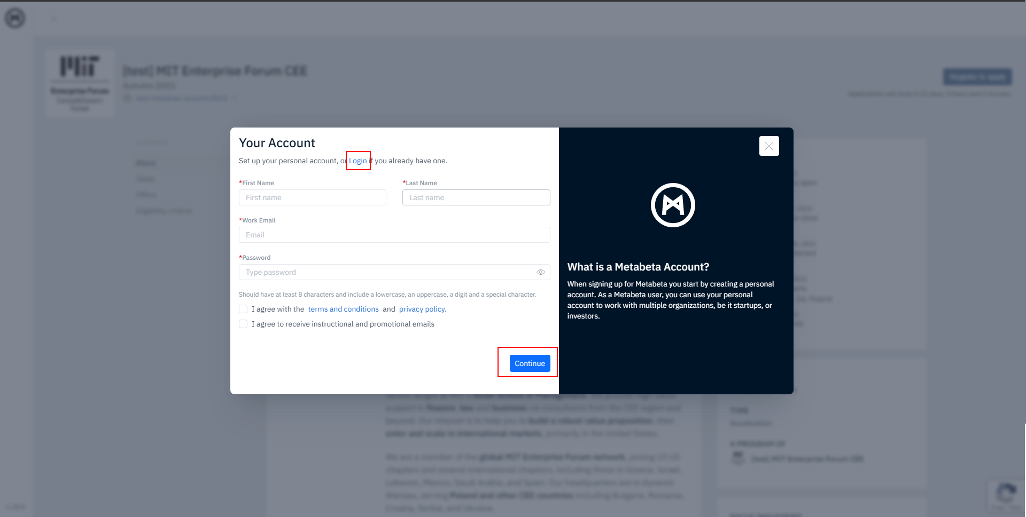
Follow the registration wizard or log in if you already have an account.
The first step requires the necessary details for creating your personal account.
The following steps are asking for information about your startup.
Steps 5 & 6 are skippable.

Slide 4
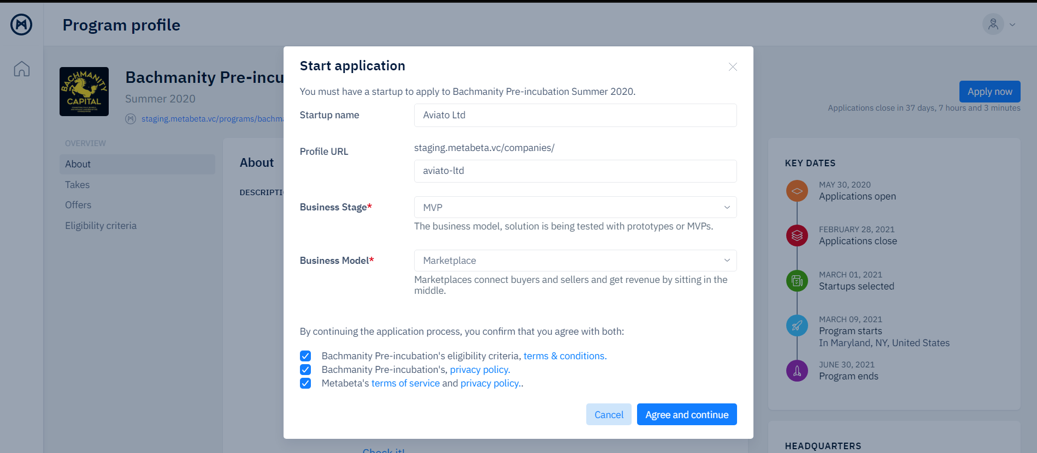
If you already have an account and you clicked login în the previous step, then click on the Apply now button after you are redirected to the program page and follow the instructions.

Slide 5
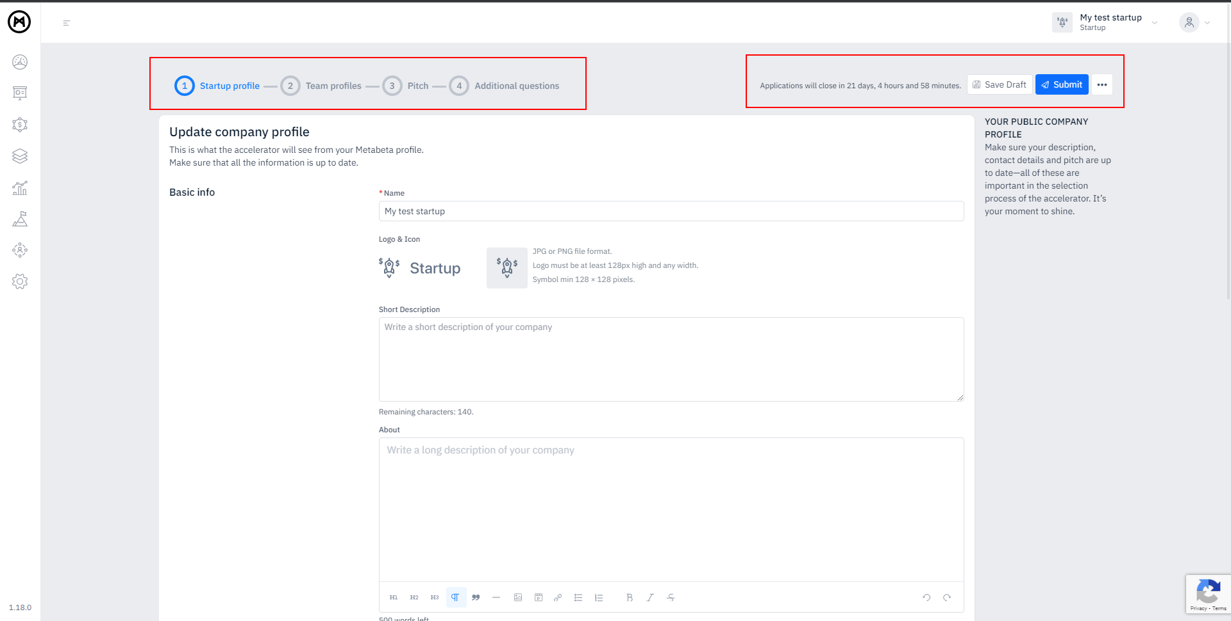
A draft application will be saved at this point.
You will get an email which also contains a link that can take you back to it.
The application has 4 steps:
Startup basic info
Personal & team members info
Pitch
Additional questions

Slide 6
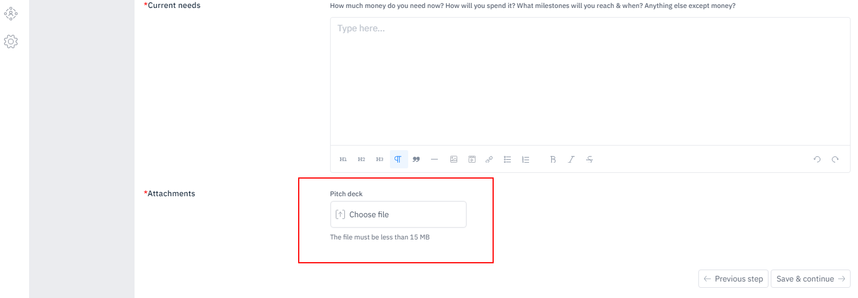
Make sure to prepare and attach Pitch deck in pdf format (max 15MB)

Slide 7
While applying you will have to answer various questions related to your solution. Please see the list here.
Problem*
What problem are you solving? How big is it (numbers please)? What proof do you have?
How do people solve it now?
Solution*
What are you building? How does it work? What are the main benefits? What is your competitive advantage?
All questions are mandatory
Market*
Who are your customers? What's the size of the initial market? How fast does it grow (CAGR)? Who are the main competitors?
Traction & go to market*
How many customers do you have? How much revenue are you generating? How fast do you grow? What is your go-to-market strategy?
Current needs*
How much money do you need now? How will you spend it? What milestones will you reach & when? Anything else except money?

Slide 8
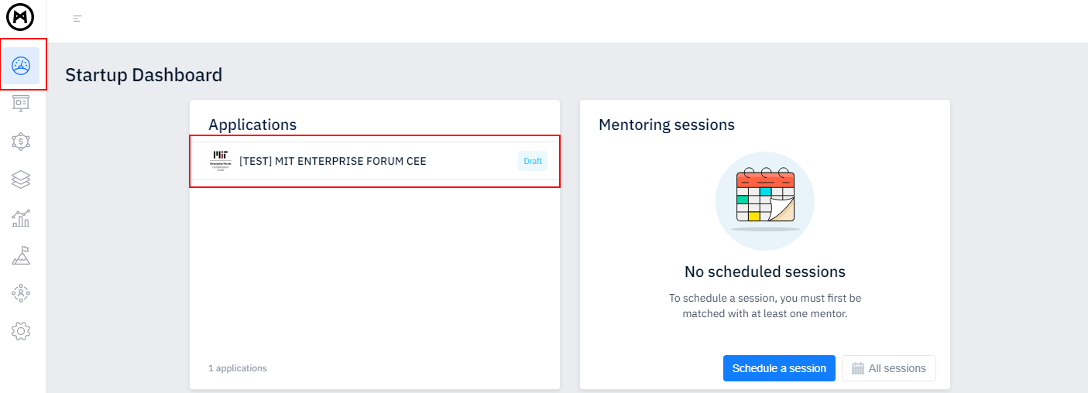
You don’t have to add all the information in one go.
Check what’s required, save your draft application, and get back to it when ready.
You’ll find your draft application on your dashboard or by clicking on the Applications icon on the left-side navigation menu.

Slide 9
OTHER IMPORTANT THINGS: Your team members need to confirm their account before you submit the application All fields in the 3rd & 4th step of the application are mandatory
For any questions related to the platform functionalities, let us know at m.bielecka@fpt.org.pl
Best of luck!

